Slide 1

Presentation in relation to heart.dk Network
Mikkel Porsborg Andersen
Ph.D, MSc.Public Health, BSc.Sports Science
Specialkonsulent i Datamanagement
Nordsjællands Hospital
E-mail: mikkel.porsborg.andersen@regionh.dk

Slide 2
Overview
The Heart.dk network setup at Statistics Denmark DST
Github
Github demo
Information on registries and variables
Slide 1 of 8

Slide 3
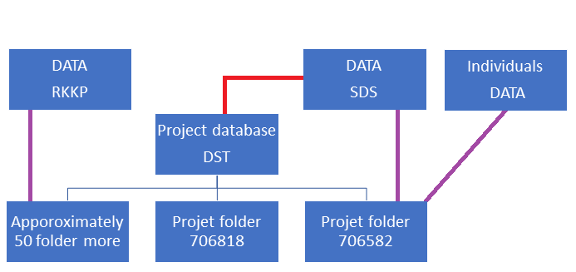
The Heart.dk network setup at Statistics Denmark DST
Approximately 250 users
Project folder structure
Data flow
Folder population
Reduce data
Github
Slide 2 of 8

Slide 4
Github
Project descriptions of project folder
Updates on project folder
Different guides in relation to the Heart.dk setup at DST
Dynamic update
Demo on the information available
Link to Heart.dk and Github
Heart.dk
Github
Slide 3 of 8

Slide 5
Information on registries and variables
Registre descriptions
Variable descriptions
Datasource dependent
Links to informations on variables from:
The Danish Health Data Authority (SDS)
Statistics Denmark (DST)
The regions’ clinical quality development program (RKKP)
Slide 4 of 8

Slide 6
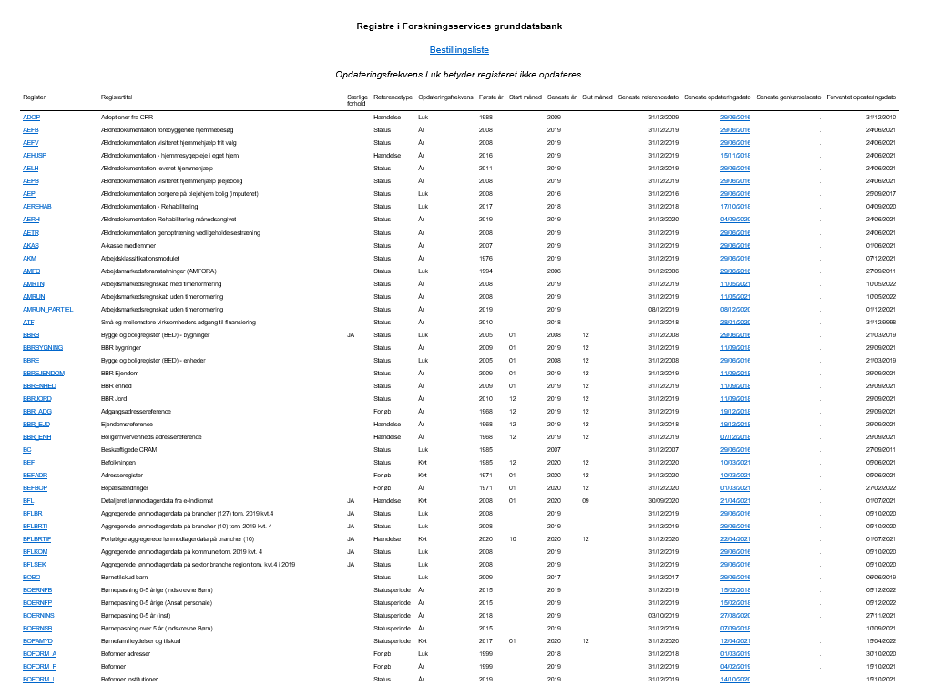
Statistics Denmark (DST)
Overview of registries at DST
Information on each registry
Important links below:
Registry in Forskningsservices grunddatabank
Documentation
Income register - IND
Slide 5 of 8

Slide 7
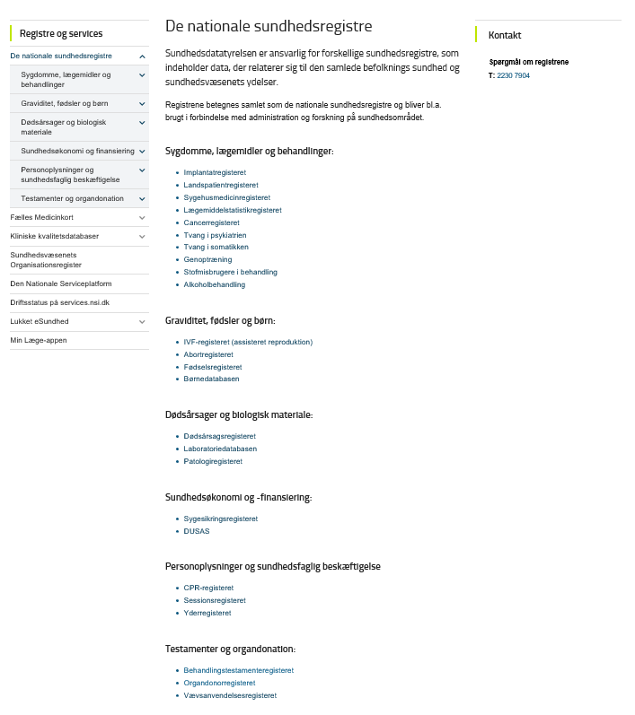
The Danish Health Data Authority (SDS)
Overview of registries at SDS
Information on each registry
Important links below:
The national health registries
Documentation
The Danish National Patient Register (LPR2)
The Danish National Patient register – temporary data model (LPR3_SB)
Slide 6 of 8

Slide 8
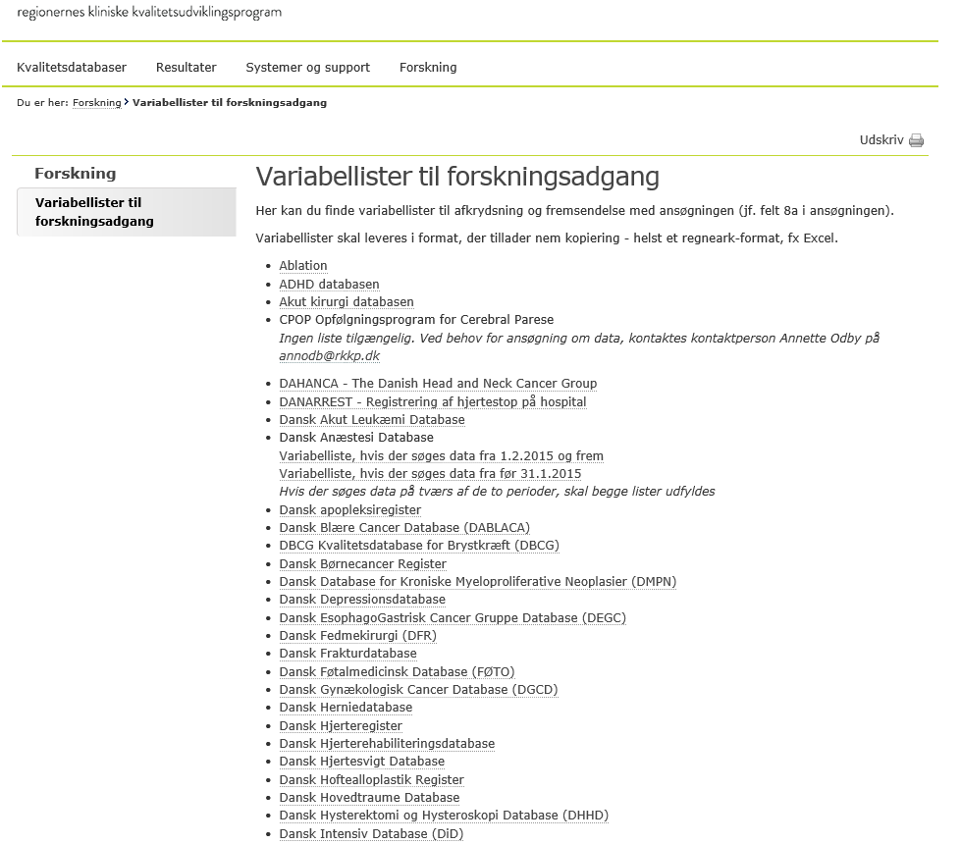
The regions’ clinical quality development program (RKKP)
Overview of database at RKKP
Information on each database
Important links below:
Clinical quality databases
Documentation
ADHD Databasen
Slide 7 of 8
https://www.rkkp.dk/forskning/variabellister-til-forskningsadgang/

Slide 9

Questions or comments
Slide 8 of 8

